Slide 1

Emotional Framing in U.S. Presidential Twitter Communication (2008–2023) A Transformer-Based Analysis of Obama, Trump, and Biden
Antonella Convertini
Università degli Studi di Milano Master in Data Science for Economics
Academic Year 2024–2025

Slide 2


Why Study Emotions in Presidential Communication?
Emotions shape how citizens: interpret events, evaluate leaders, decide whether to participate in politics.
Political elites deploy emotions strategically:
Anger → mobilisation, polarisation.
Fear → support for security policies.
Hope / optimism / pride → competence and national unity.
Twitter gives presidents a direct, largely unfiltered channel to millions of followers.

Slide 3


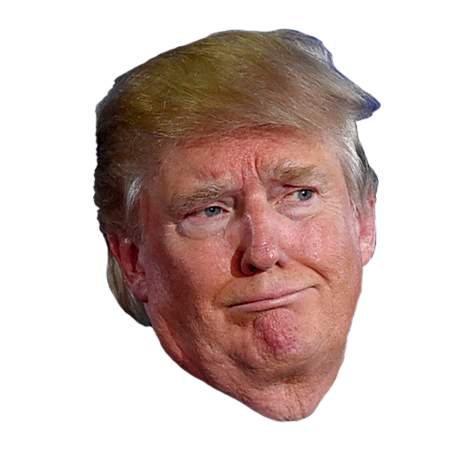
Presidents and the Twitter Environment
Barack Obama Pioneer of social-media-based campaigning (2008, 2012).
Donald Trump Turned Twitter into his primary medium of political communication.
Joe Biden Inherits the platform during multiple crises: COVID-19, democratic backsliding concerns, economic recovery.

Slide 4
Let’s ask ourselves a few question
How do different U.S. presidents strategically employ emotional framing on Twitter, and how does this vary across actors, topics, time periods, and political contexts?
Are campaign periods more negative and mobilising than presidencies?
Which emotions dominate each president’s communication style?
How are emotions targeted toward self, opponents, policy issues, or other actors?
How do emotions vary across policy topics (economy, immigration, healthcare, security, environment, . . . )?

Slide 5
How to answer?
Step 1: Data ingestion Import CSV files with tweets from Obama, Trump, Biden. Parse timestamps and tag tweets as campaign or presidency based on each actor’s electoral timeline.
1
Step 2: Pre-processing and balancing Lowercase text, remove URLs and user handles, strip non-ASCII noise. To keep computation tractable and avoid imbalance: downsample each actor–phase combination to at most 1,500 tweets.
2
Step 3: Topic and target labelling Apply keyword-based rules to assign: one of eight topics (economy, immigration, healthcare, . . . ), one rhetorical target: self, opponent, issue, or other.
3
Step 4: Emotion classification Use DistillBERT: BERT transformer fine-tuned on the GoEmotions dataset. For each tweet: obtain probabilities for 27 fine-grained emotions, then map to 7 key emotions + valence.
4
Step 5: Aggregation and visualisation Compute emotion shares by actor, phase, topic, target, and month. Generate: stacked bar plots for valence, bar plots and heatmaps by topic and target, time series for anger/fear and positive emotions.
5
Step 6: Explainability Apply SHAP to produce token-level force plots. Inspect last-layer attention to visualise which words attend to each other in emotional predictions.
6

Slide 6
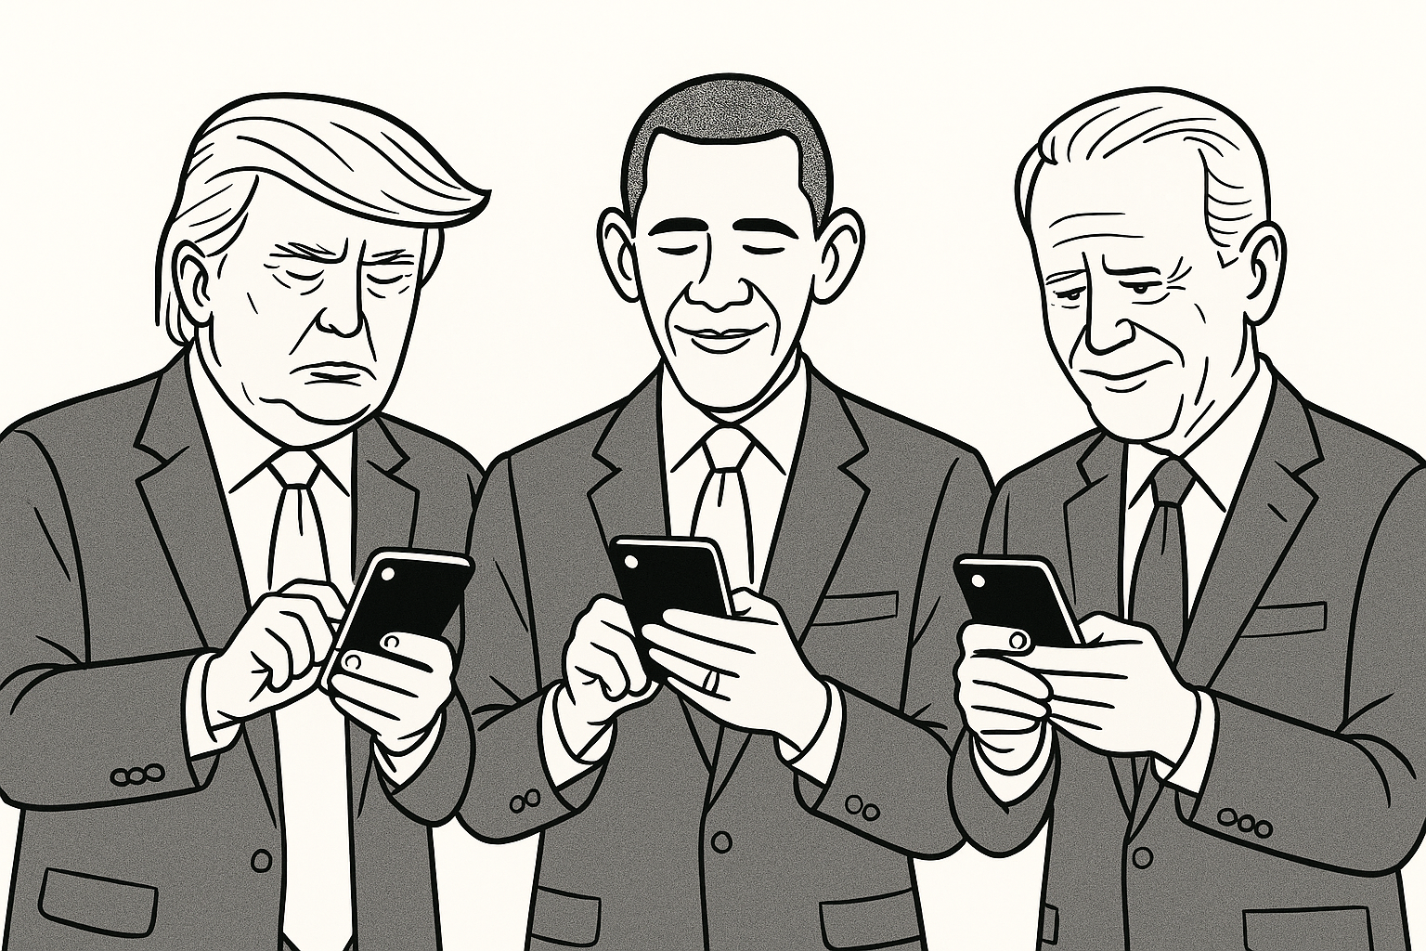
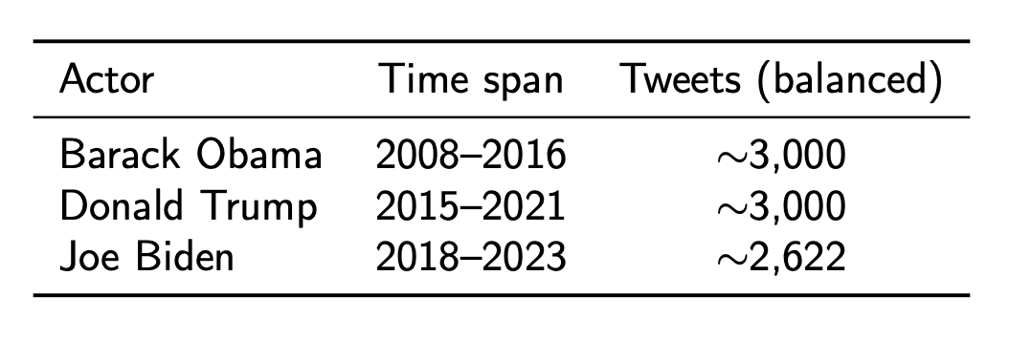
Balanced Dataset

Slide 7
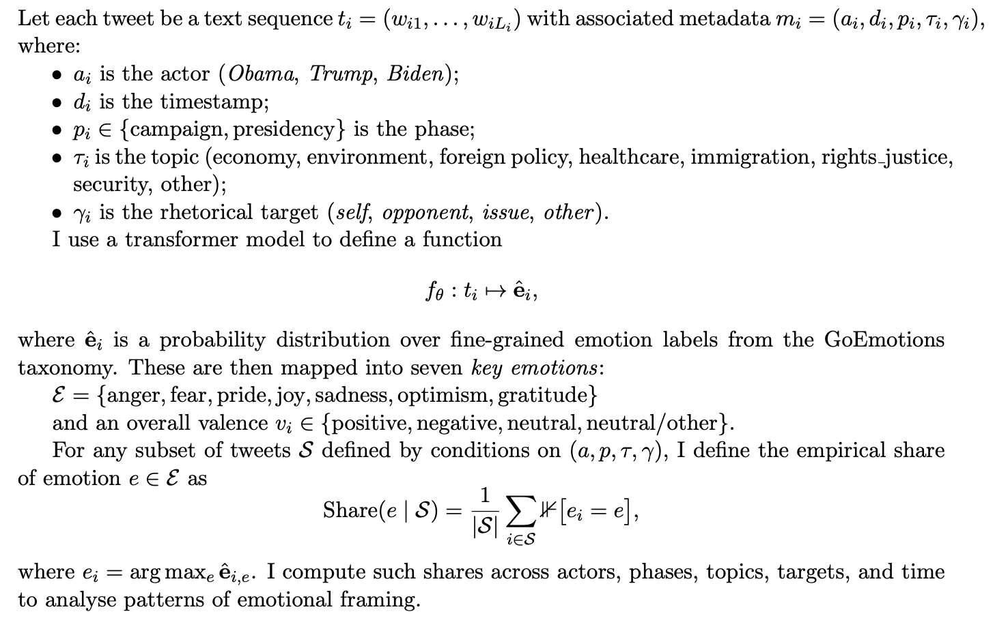
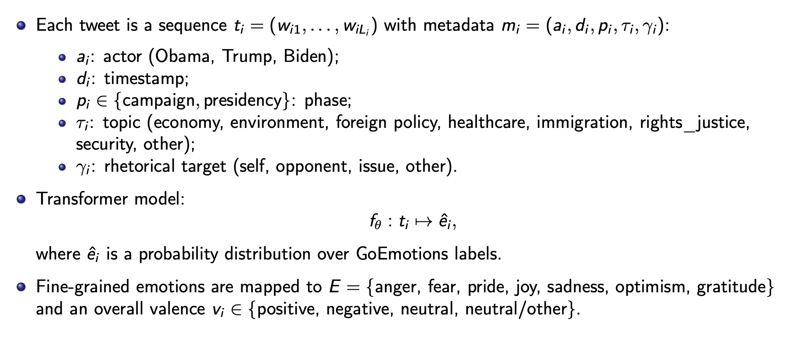
Problem Formulation

Slide 8
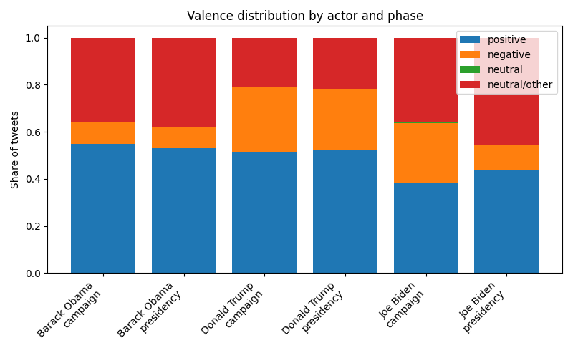
Valence
Campaign periods are more negative than presidencies for all actors.
Effect is strongest for Donald Trump whose campaign shows the highest share of negative valence.
During presidencies, all three move towards more positive/neutral tone, but Trump remains more negative than Obama and Biden.

Slide 9
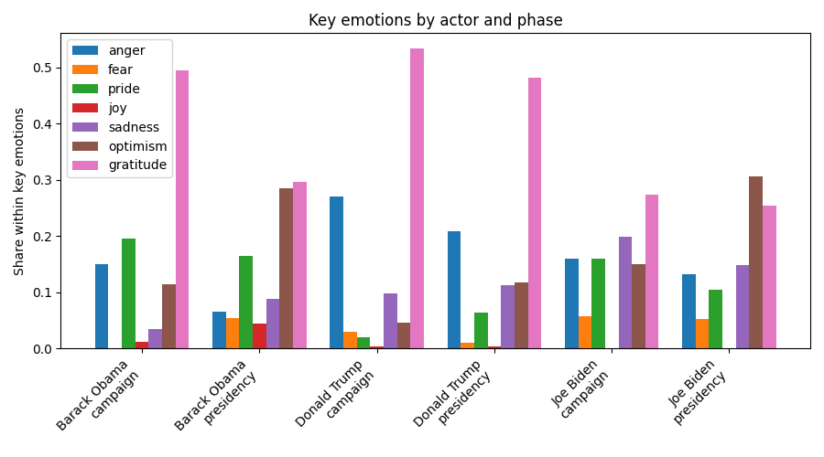
Let’s dig a little bit

Slide 10
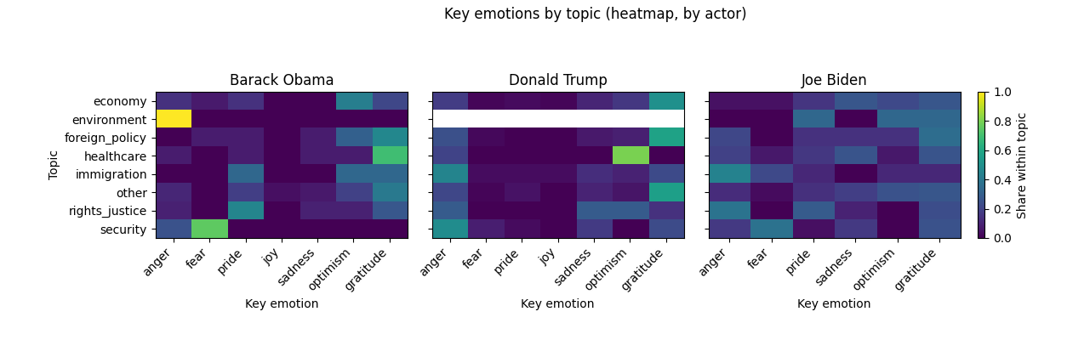
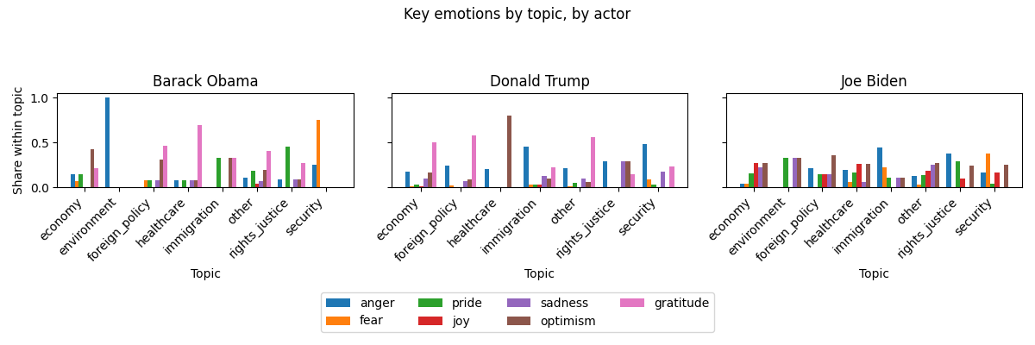
Immigration and security: Trump shows strong anger and sadness, consistent with hard-line framing.
Rights/justice: Biden displays anger when discussing democracy and voting rights.
Healthcare and economy: Biden uses optimism and gratitude during vaccine rollout and recovery.
Environment: Obama frequently uses fear to frame climate risks.
Trump shows limited emotional engagement with environmental issues.

Slide 11
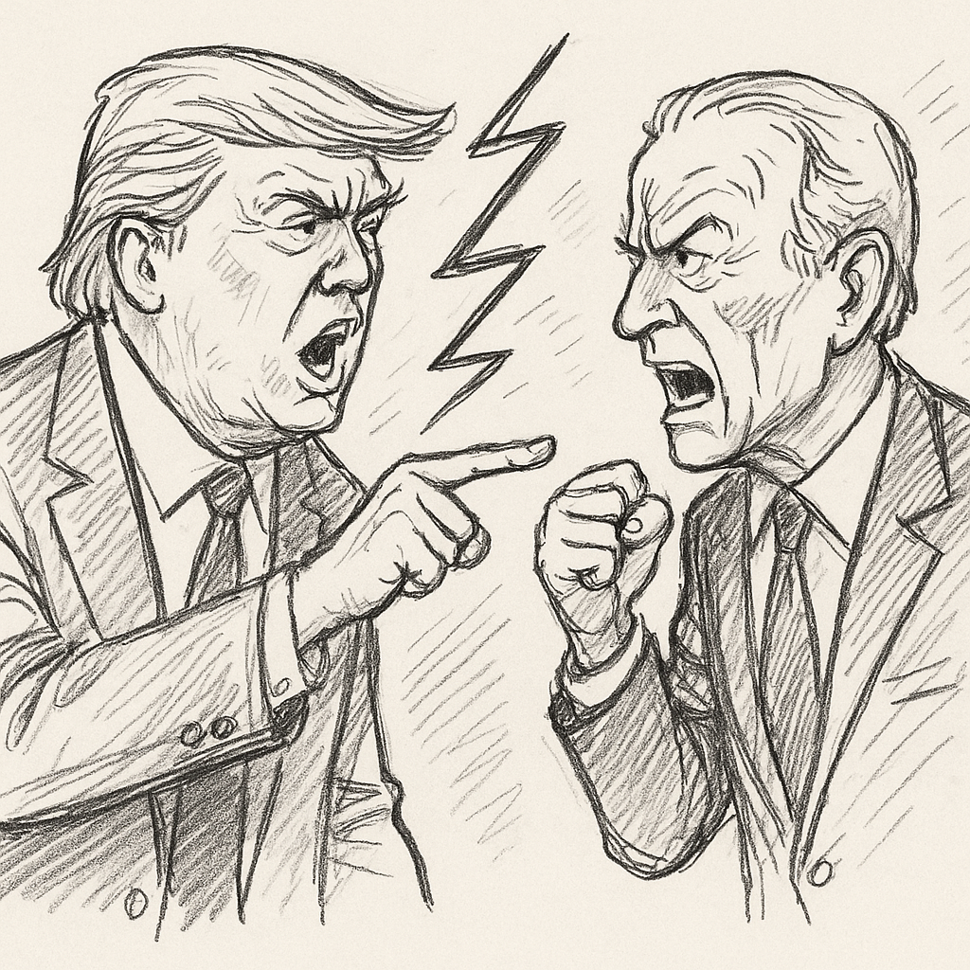
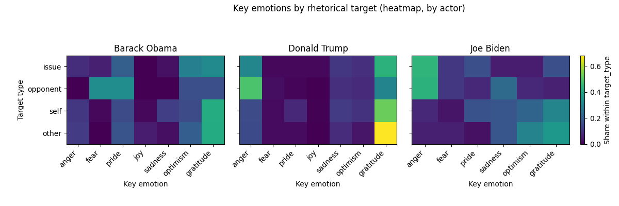
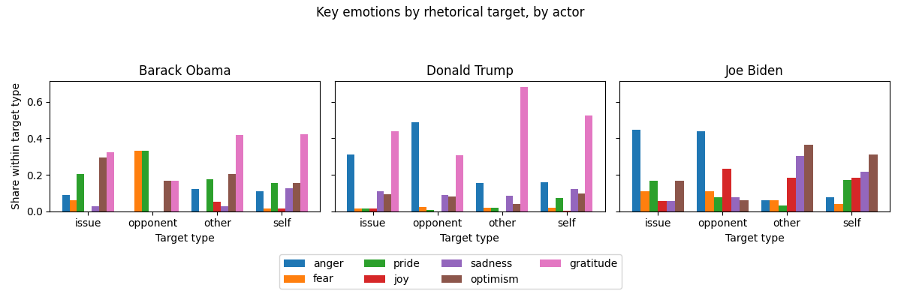
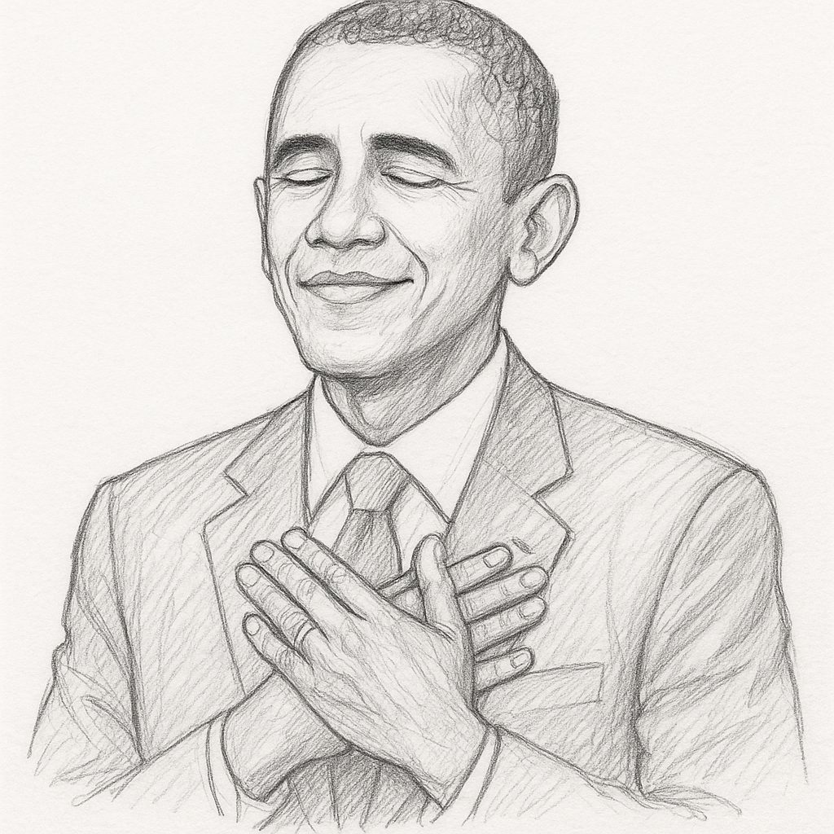
Anger is concentrated on opponents, especially for Trump and Biden.
Self-referential tweets are dominated by gratitude and pride.
Issue-focused messages mix fear (crises, risks) and optimism (policy plans).

Slide 12
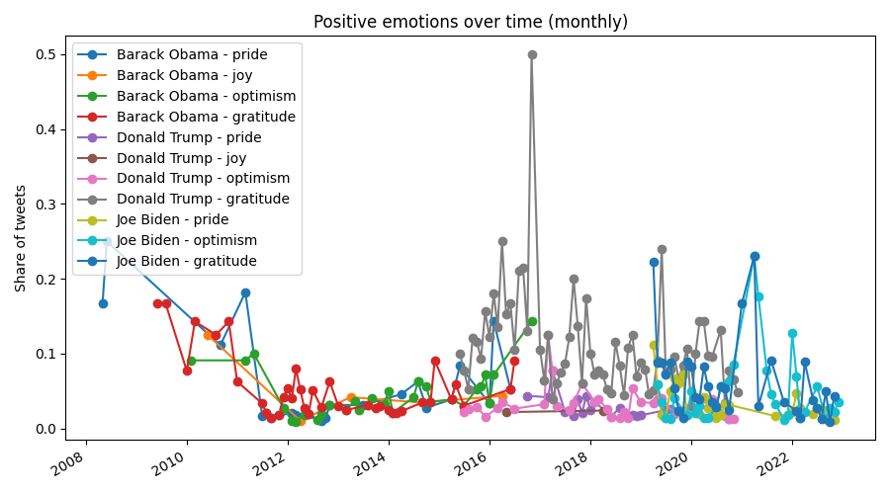
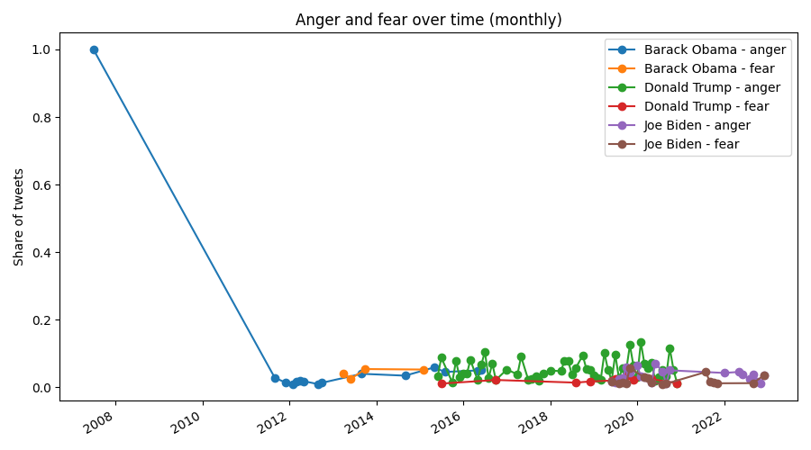
Emotion rollercoaster
Peaks and troughs related to political events in the United States.
Obama: Occasional increases in fear coincide with debates on climate change and mass shootings, where Obama emphasised risk and urgency.
Trump: Anger displays large spikes around: 2016 election campaign and early presidency; 2017 travel ban and immigration controversies; 2018 midterm elections and 2020 election and its aftermath.
Biden: Negative emotions increase around the 2020 election, the January 6th attack, and the height of the COVID-19 pandemic. Positive emotions, particularly optimism and gratitude, rise during the vaccine rollout and economic recovery announcements in 2021--2022, reflecting an attempt to project competence and hope.

Slide 13
SHAP Explainability and Attention
Tweet: “Employment is up, Taxes are DOWN. Enjoy!”
Model assigns high probability to joy.
SHAP shows that Employment, up, DOWN, and especially Enjoy strongly raise the joy score;
Function words and punctuation have almost no effect.
Consistent with a celebratory, self-congratulatory frame around economic success.
Mobilisation tweet about the Georgia Senate election.
Model predicts elevated anger.
SHAP highlights phrases such as Election Day, eyes of the nation, on you as main drivers of anger.
Reflects a morally charged call to action: the election is framed as a high-stakes national moment.
Extract attention weights from the final transformer layer.
Emotion classification tokens strongly attend to:
emotionally loaded words (fight, wrong, attacks),
evaluative phrases (keep America safe, eyes of the nation, etc.).
Suggests the model focuses on intuitive emotional triggers rather than artefacts of preprocessing or noise.

Slide 14

Summary of findings
Campaign periods are systematically more negative than presidencies for all three actors.
Obama relies heavily on gratitude, optimism, and pride, with minimal anger.
Trump uses anger far more often, especially on immigration and security and when attacking opponents.
Biden combines gratitude and optimism with notable sadness (COVID-19 context) and anger when condemning threats to democracy.
Topic/target heatmaps show:
fear tied to environmental risks and crises,
anger to opponents and contested issues,
gratitude to self-referential or supporter-directed messages.
Temporal trends track major events: anger spikes around elections and crises; positive emotions rise during phases of recovery and policy success.

Slide 15

Limitations and looking at the future
Single platform: only Twitter is analysed; future work should include speeches, press conferences and other social media.
Model bias / domain shift: GoEmotions is trained on Reddit comments, not presidential language;
Causal inference: current analysis is descriptive; link emotional patterns to approval, polling and media coverage to study impact.
Cross-national comparison: apply the pipeline to other leaders (e.g. Italian prime ministers Meloni, Conte, Draghi) to compare emotional strategies across systems.

Slide 16
Conclusions
Emotion is a strategic resource in presidential communication.
Transformer models + GoEmotions enable systematic analysis of emotional framing.
Different presidents construct distinct emotional narratives:
Obama: hopeful mobilisation.
Trump: angry populism.
Biden: mixture of mourning and recovery.
The pipeline is reusable for studying emotional framing in other actors, languages, and media.

Slide 17
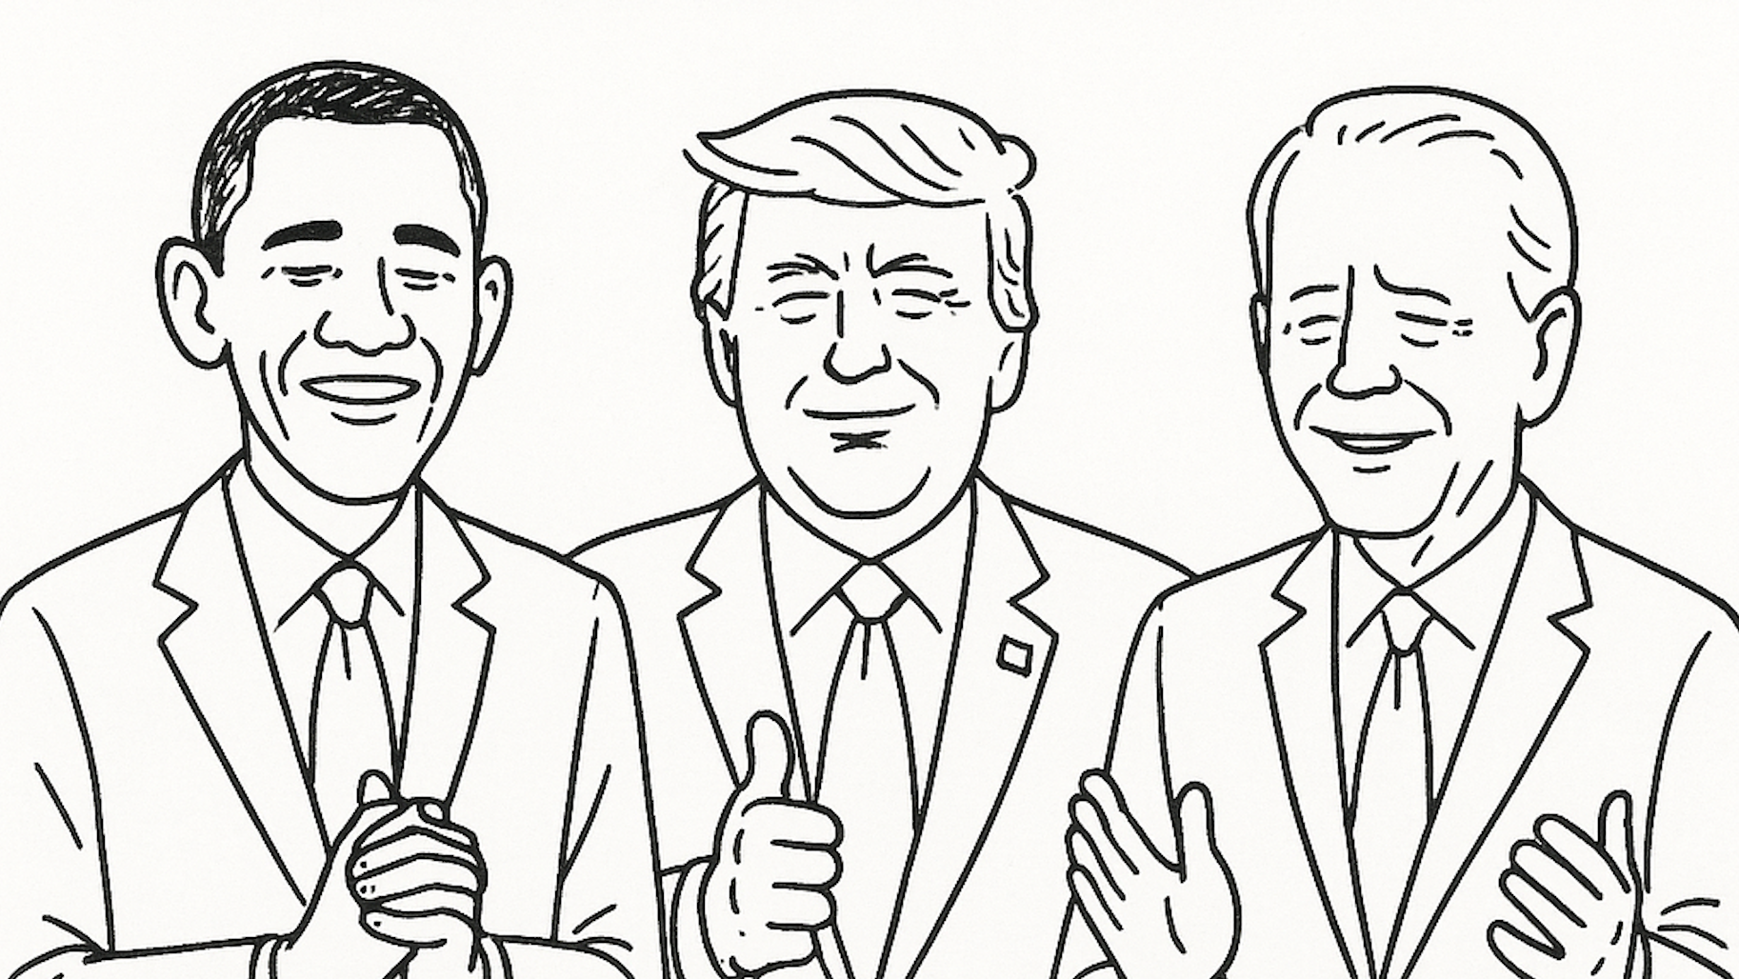
Thank you for your attention!

